Slide 1



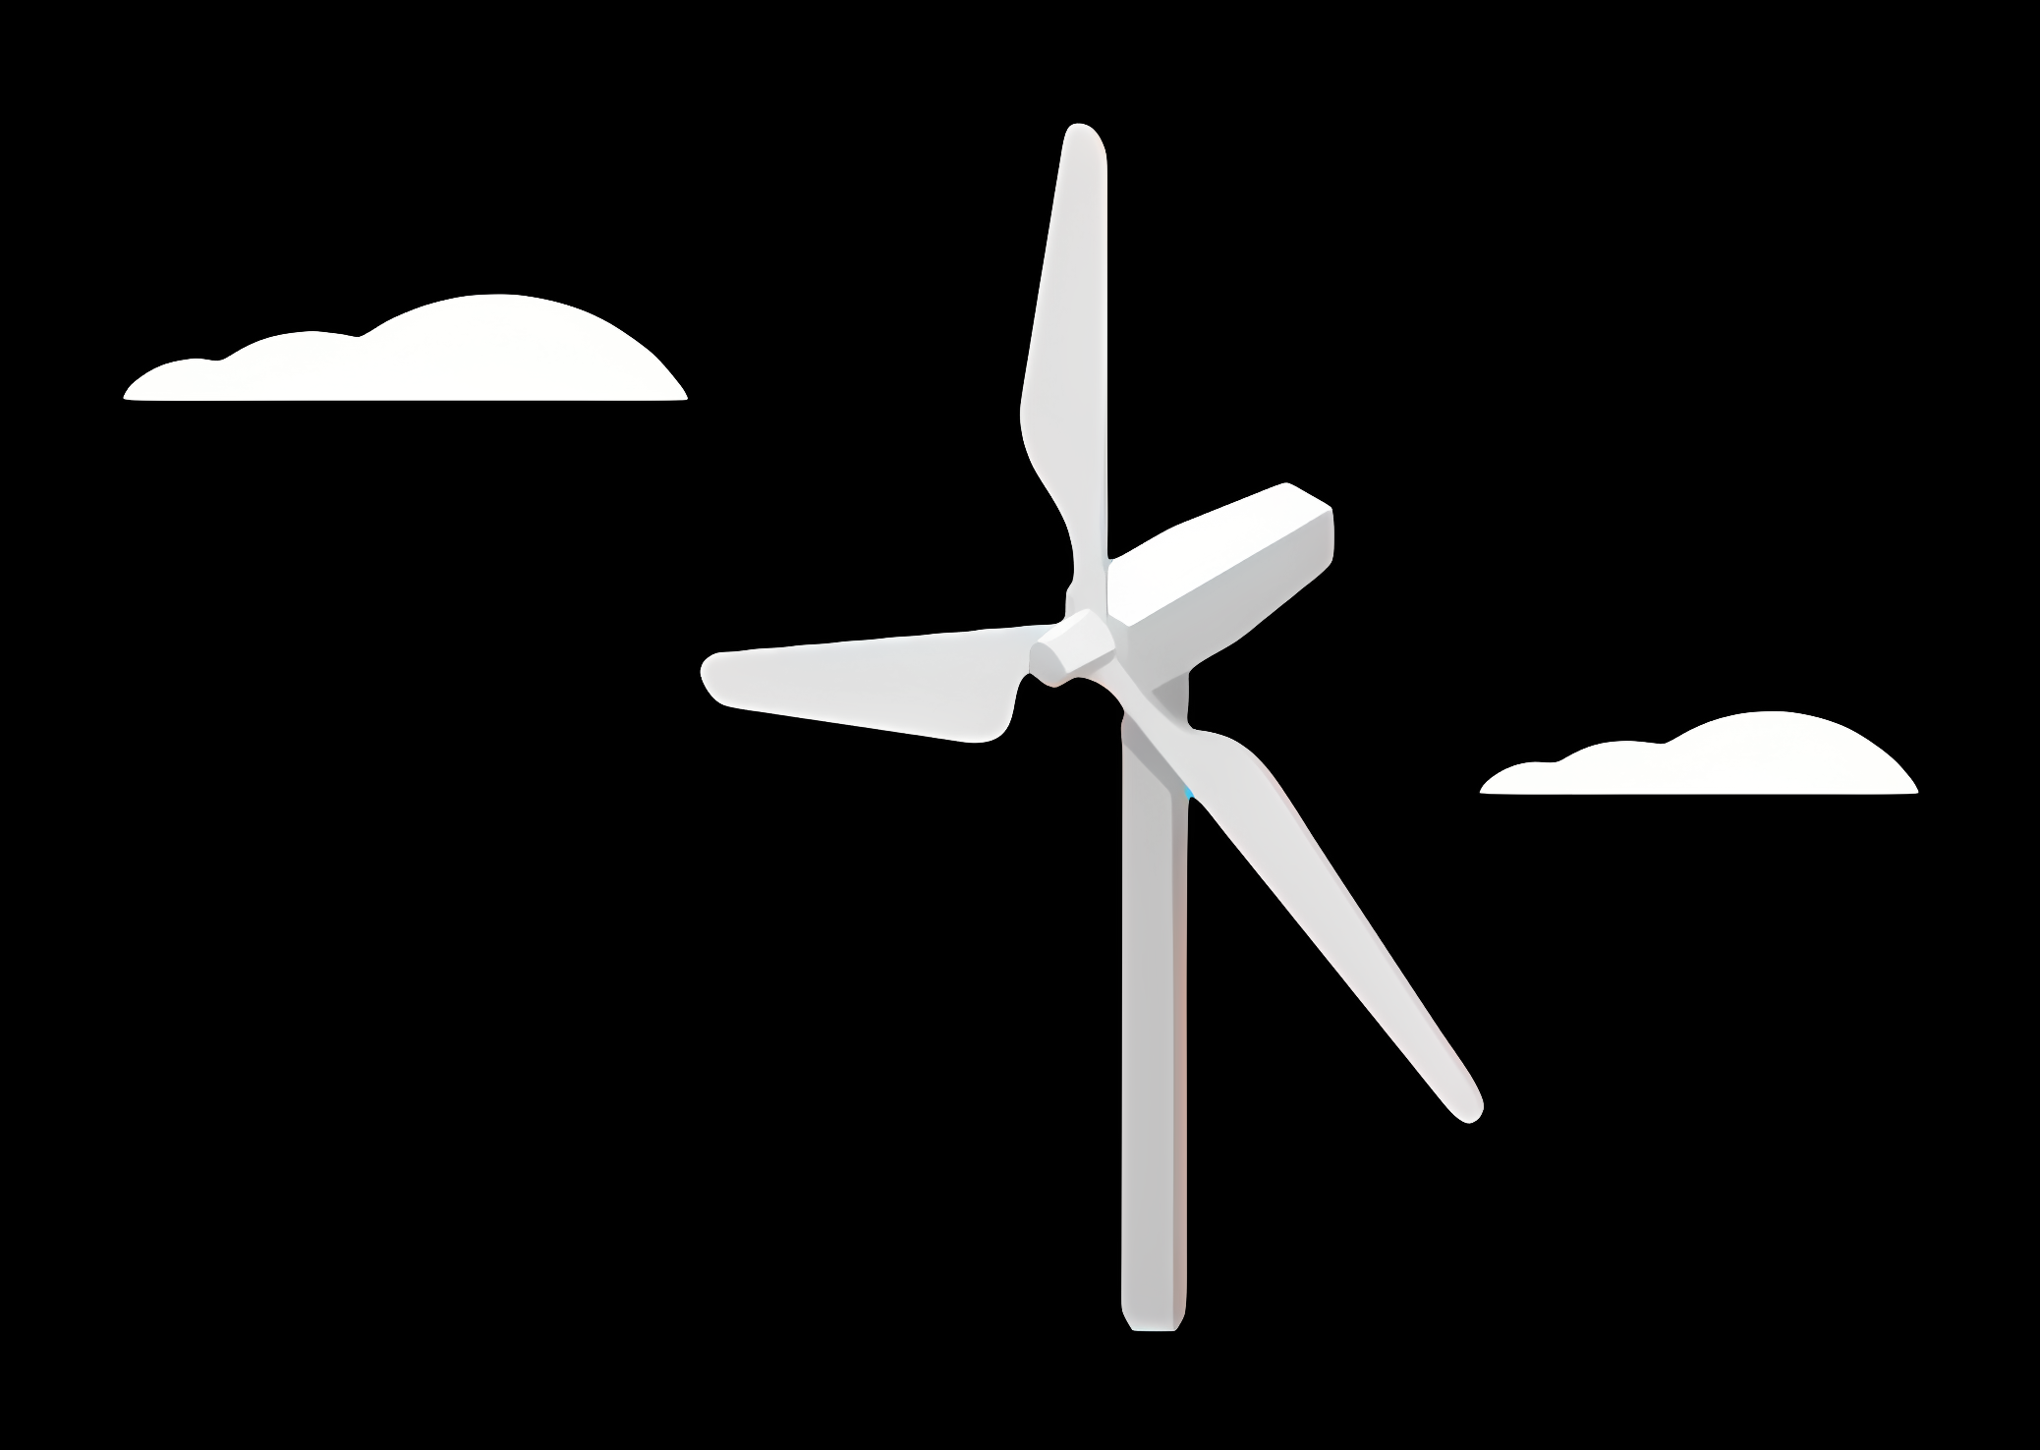
Weekly report: Load & Dynamics
Week number: 03
Date: 14/10/2025
Supervisor: Mr. Manjock
Group members: Md Aman, Arham Memon, Paresh Nakum
Presented By - Paresh Nakum
14/10/2025
Md Aman, Arham Memon, Paresh Nakum
Optimus Syria

Slide 2
Agenda
Environmental Inputs (Syria-Relevant)
Simulated Loads
OpenFAST Load Simulation Inputs
TurbSim Input File (XY.inp)
OpenFAST Inflow File (XY_Inflow.dat)
Wind Time Series Variations
Conceptual Illustration
Future Plans
14/10/2025
Paresh Nakum
Load & Dynamics Team/ Optimus Syria

Slide 3
Environmental Inputs
Parameter | Typical Range / Note
Mean wind speed hub | 8-10 m/s
Turbulence intensity | 0.16
Shear exponent (α) | 0.10–0.25
Extreme gusts | From ERA5 or IEC EOG model
Air density | 1.25 kg/m³
Seismic hazard | Moderate–high (Dead Sea / East Anatolian faults)
Other | Dust storms, temperature swings, corrosion factors
*data and research from wind farm group
14/10/2025
3
Paresh Nakum
Load & Dynamics Team/ Optimus Syria

Slide 4
Simulated Loads
Simulation Type | Goal | Typical IEC Case
Normal Operation | Evaluate fatigue and performance | DLC 1.1, 1.2,
Extreme Wind Conditions | Check survival loads | DLC 1.3, 6.1
Startup/ Shutdown/ Fault | Check transient response | DLC 2.1, 2.2, 2.3
Parked/ Standby | Idle or a storm survival | DLC 6.3
*DLC (“Design Load Case”) defines wind, wave, and control conditions to simulate.
Source: DNVGL-ST-0437:2016
14/10/2025
4
Paresh Nakum
Load & Dynamics Team/ Optimus Syria

Slide 5
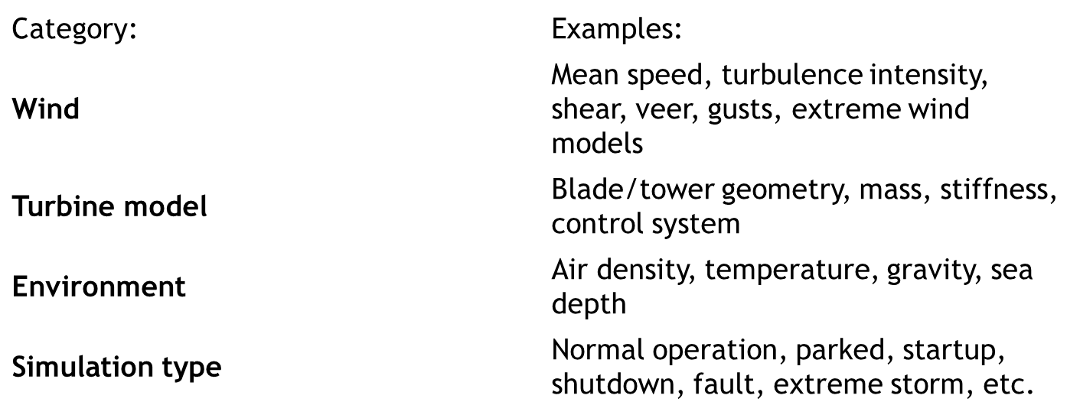
OpenFAST Load Simulations
Parameter needs to be analyzed
14/10/2025
5
Paresh Nakum
Load & Dynamics Team/ Optimus Syria

Slide 6
TurbSim Input File
Changes in the reference NREL TurbSim according to Optimus Syria Project
Parameter | NREL 5 MW (126 m) | Optimus Syria 5 MW (160 m)
Hub Height (m) | 90 | 120
Rotor Diameter (m) | 126 | 160
Mean Wind Speed, URef (m/s) | 8.0 – 11.4 | 7.5
Turbulence Intensity (TI) | 0.12 | 0.16
Shear Exponent | 0.14 | (0.12 – 0.18)
Roughness Length, Z₀ (m) | 0.1 | 0.03 (Not Fixed)
Turbulence Model | IECKAI (Kaimal) | IECKAI / Mann
Length Scale, Lᵤ (m) | 75 | (85 – 100)
Time Step, DT (s) | 0.05 | 0.05
Simulation Time (s) | 600 | 660
Grid Size (vertical × lateral) | 41 × 41 | (41 × 41 or 51 × 51)(Not Fixed)
14/10/2025
6
Paresh Nakum
Load & Dynamics Team/ Optimus Syria

Slide 7
OpenFAST 3.0 Inflow File
Parameter | NREL 5-MW (126 m) | Optimus Syria 5-MW (160 m)
Rated Power | 5 MW | 5 MW
Rotor Diameter | 126 m | 160 m
Hub Height | 90 m | 120 m
Rated Wind Speed | 11.4 m/s | 7.5 m/s
Rated Rotor Speed | 12.1 rpm | 9–10 rpm (Not Fixed)
File Reference | Baseline | XY.inp
Flow Angle | 0 degree | 5-10 degree
Gearbox Ratio | 97:1 | ~100:1 (varies by design)
Tip Speed | 80 m/s | 80 m/s
Power Coefficient (Cₚ,max) | 0.482 | ~0.48–0.50
14/10/2025
7
Paresh Nakum
Load & Dynamics Team/ Optimus Syria

Slide 8
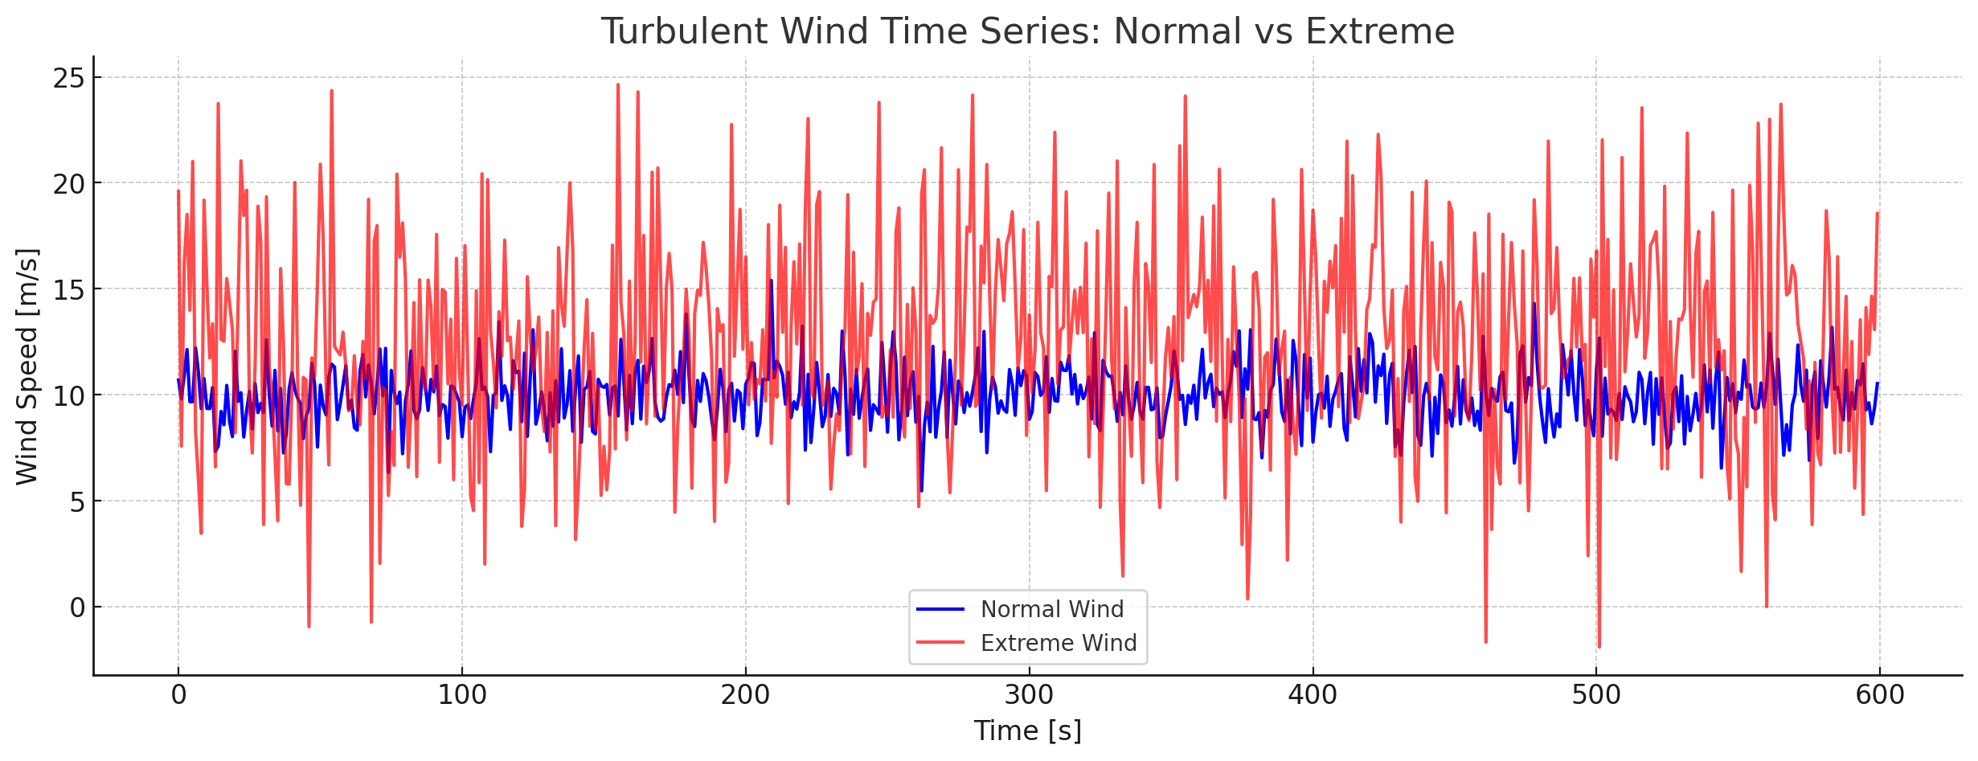
Wind Time Series
Blue line: normal wind - fluctuates gently around 10 m/s, representing typical turbulence.
Red line: extreme wind - higher mean speed (≈12 m/s) with strong fluctuations and sudden gusts (spikes), representing rare or storm-like conditions.
You can clearly see how extreme wind files have both larger turbulence intensity and short-duration spikes, while normal wind remains relatively smooth.
*Image from other source
14/10/2025
8
Paresh Nakum
Load & Dynamics Team/ Optimus Syria

Slide 9
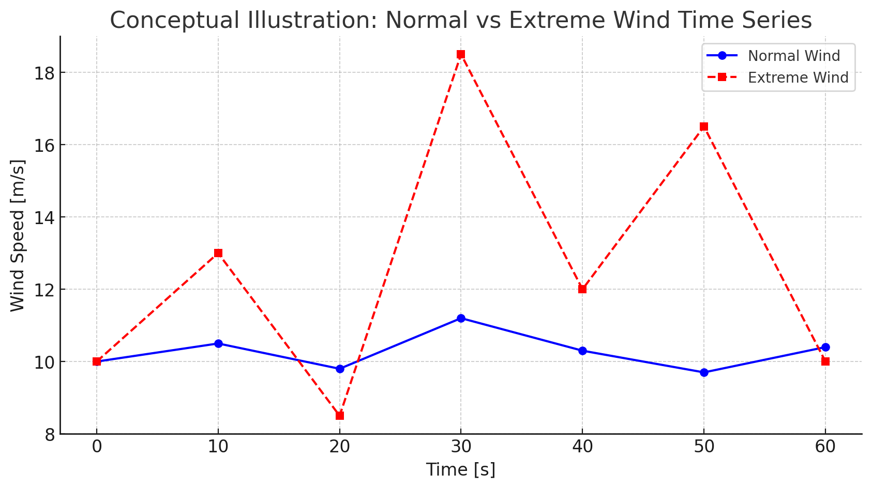
Conceptual Illustration
Time (s) | Normal wind (m/s) | Extreme wind (m/s)
0 | 10.0 | 10.0
10 | 10.5 | 13.0
20 | 9.8 | 8.5
30 | 11.2 | 18.5 (gust)
40 | 10.3 | 12.0
50 | 9.7 | 16.5 (gust)
60 | 10.4 | 10.0
Normal wind file: looks like a slightly wavy signal around 10 m/s, with small, random fluctuations (turbulence intensity ≈ 10–15%).
Extreme wind file: shows violent spikes and sharp transitions — gusts up to +80% of the mean wind speed, with short correlation times.
Blue line (Normal Wind): smooth variations around 10 m/s - typical design conditions.
Red Line (Extreme Wind): sharp peaks & strong fluctuations representing gusts& severe turbulence events.
14/10/2025
9
Paresh Nakum
Load & Dynamics Team/ Optimus Syria

Slide 10
Future Plan
In the next week We’ll
Configure OpenFast
Create Turbulent wind Field (precise data) with TurbSim
Start With Other parameters DLC
Connect with controller group for simulations
14/10/2025
10
Paresh Nakum
Load & Dynamics Team/ Optimus Syria

Slide 11
References
Load Reports of the OPTIMUS projects
Loads and site conditions for wind turbines, DNVGL-ST-437,Edition November 2016
TurbSim, OpenFAST & NREL 5 MW
Load Simulation Seminar 2025 by Mr. Manjock
14/10/2025
11
Paresh Nakum
Load & Dynamics Team/ Optimus Syria

